Slide 1
WELCOME

Slide 2


BALLARI INSTITUTE OF TECHNOLOGY AND MANAGEMENT DEPARTMENT OF COMPUTER SCIENCE AND ENGINEERING SMART CRADLE SYSTEM
UNDER THE GUIDANCE OF: DEMO ON
DR. R.N KULKARNI PROJECT WORK PHASE 2
(PROFESSOR AND HOD, DEPT OF CSE) PRESENTED BY
V SHIVNARAYAN

Slide 3
DEMONSTRATION

Slide 4
METHODOLOGY

Slide 5
Abstract:
This project portrays the configuration of a programmed cradle which fundamentally chips away at location of infant development with the assistance of a motion sensor. Motion sensor detects the movement of infant.
After the location of enlivening of infant various occasions are terminated which incorporate sending notices to parents by google firebase and e-mail, swinging of cradle with the goal that the child feels good.
The cradle likewise incorporates extra gimmicks like observing the temperature of the infant to give therapeutic thoughtfulness regarding the child and cautions the parents if the body temperature of the child goes above to given threshold temperature.

Slide 6
Objectives Of Project:
To Develop a smart baby care system with features for monitoring baby movements, detect bed-wet condition and body temperature.
Use different types of sensors such as motion sensor, temperature sensor to keep the baby safe and comfortable.
Innovative cradle that is flexible and reliable.
A user friendly system.

Slide 7
PROBLEM STATEMENT:
To design and develop a smart cradle system for remote monitoring of baby as well provide safe and comfortable experience to cradled infants.

Slide 8
Functional Requirements:
The System should be able to perform various tasks such as detecting baby’s movement, check for bed-wet condition, check body temperature etc.
Notification regarding baby’s condition should be sent to parents/guardians at regular intervals.
The system should be able to soothe baby to make it feel comfortable.
The system should also have a monitoring system to monitor baby.

Slide 9
non-functional requirements:
Reliability : The capability to maintain specified level of performance is called reliability. Unauthorized person will not be able to use the system.
Availability : The system must be readily available to users, (24/7).
Security : System must be highly secured and must authenticate users strictly.
Maintainability : System must be easy to maintain. Users should be able to sort any issue that arise.
Accessibility : Should be accessible by members to whom the user has grant access.
Scalability : The system should be able to accommodate additional features when required.

Slide 10
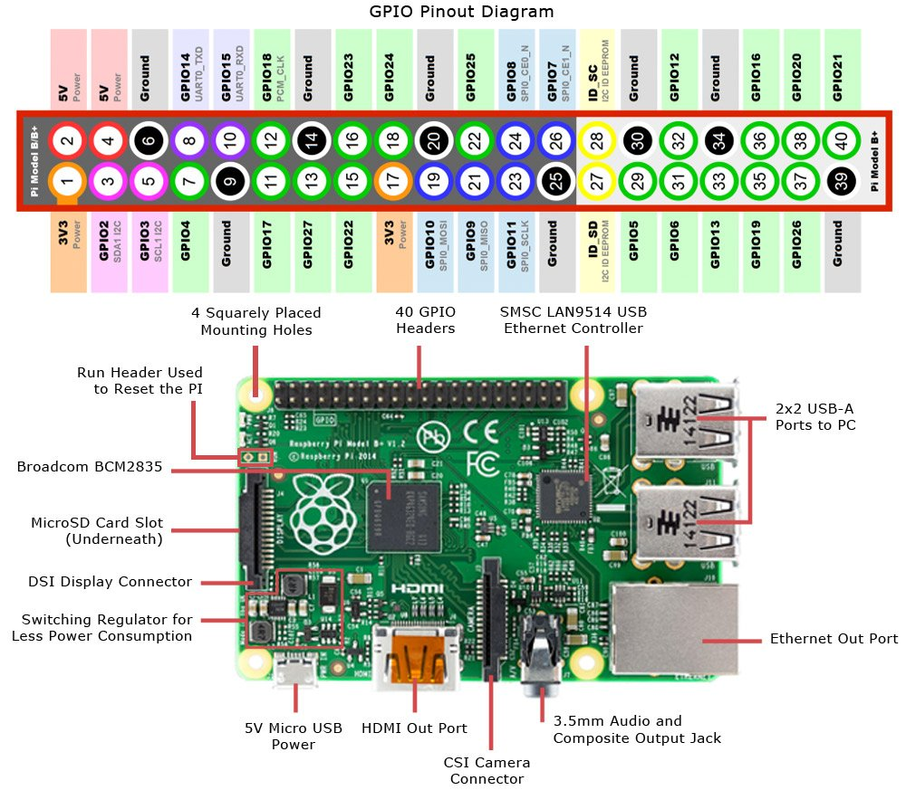
RASPBERRY PI ARCHITECTURE:

Slide 11
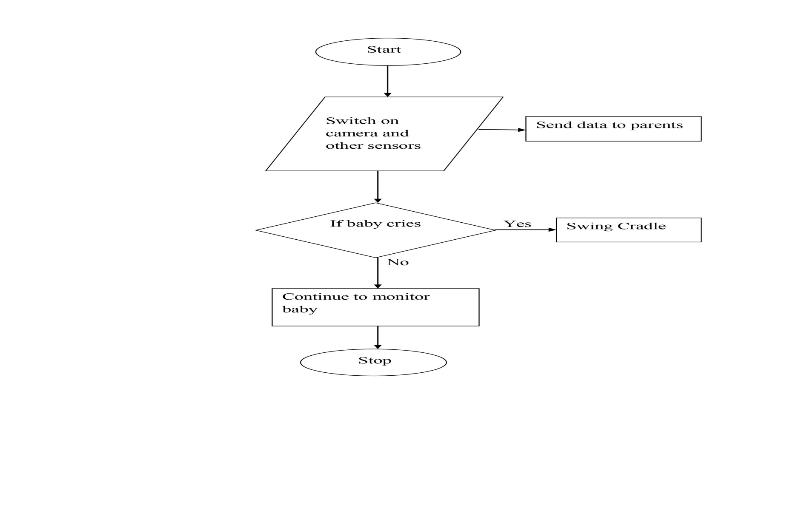
Smart cradle SYSTEM Flow Chart:

Slide 12
Description Of Modules:
Motion Sensor: A passive infrared sensor is a solid sensor that measures infrared light radiating from objects in its field of view. It is a solid sensor or set of sensors made from pyro electric material which generates energy when exposed to heat. That’s why its also called pyro electric infrared sensor.
Raspberry Pi: Raspberry Pi is a series of small single-board computers.
Temperature and wet Sensor: It is used for measuring body temperature and humidity.
Servo Motor: Used for swinging the cradle.
Power Source: Used to power the entire system, a 5v charger is used here.
Advanced IP Scanner: Used for network scanning.

Slide 13
results
The proposed system performs the following operations:
1. Remote monitoring, 2. Measuring baby’s temperature, humidity and bed wetness using temperature and wet sensor, 3. Detecting movements of baby through motion sensor and 4. Swing the cradle to soothe baby if it feels uncomfortable.

Slide 14
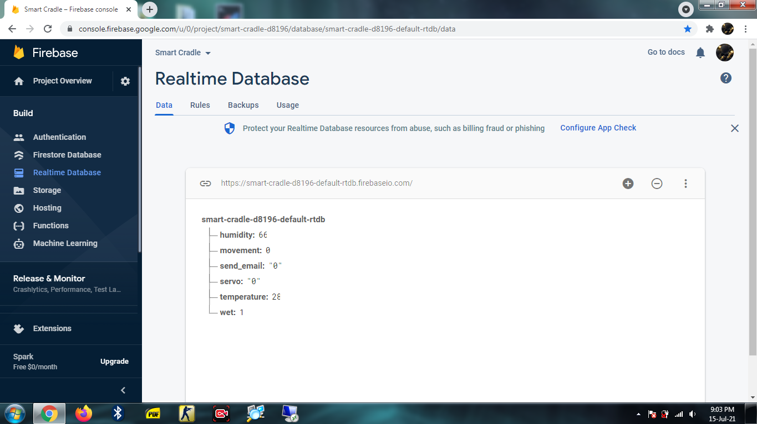
Temperature and humidity data

Slide 15
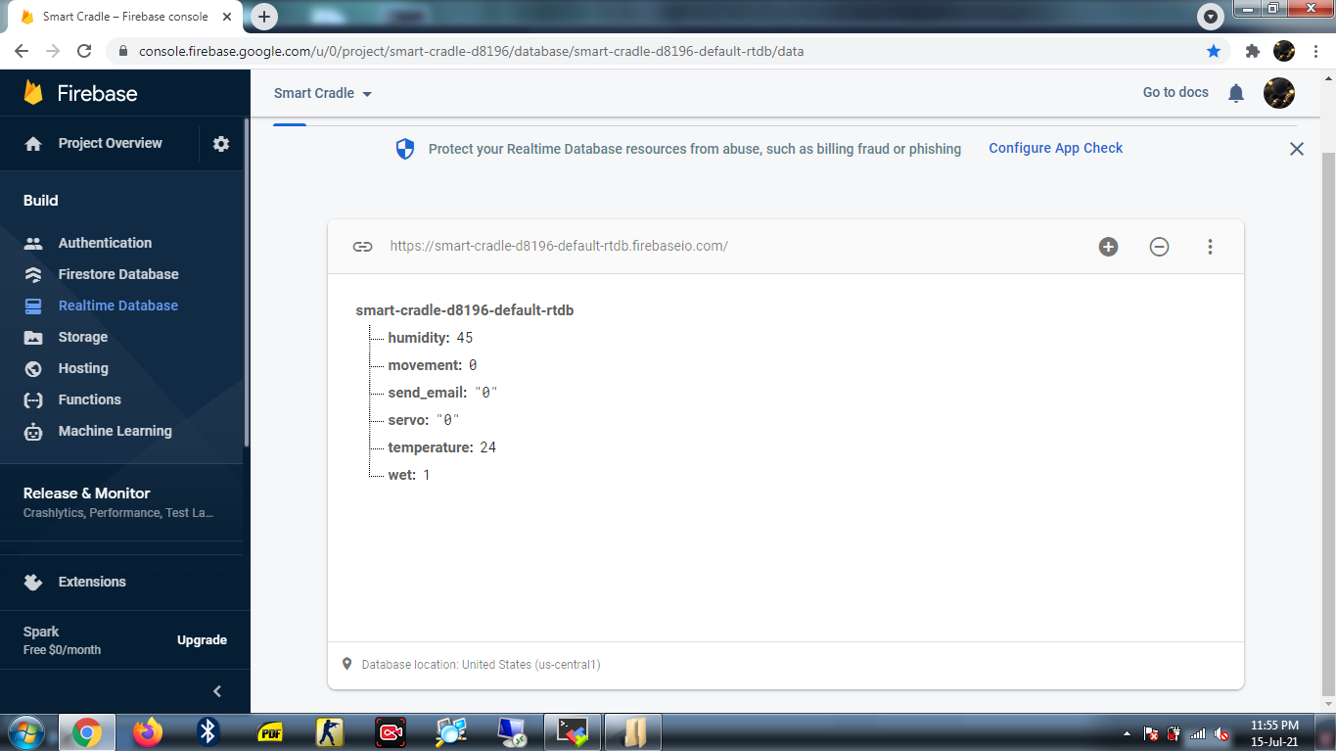
Test result 2

Slide 16
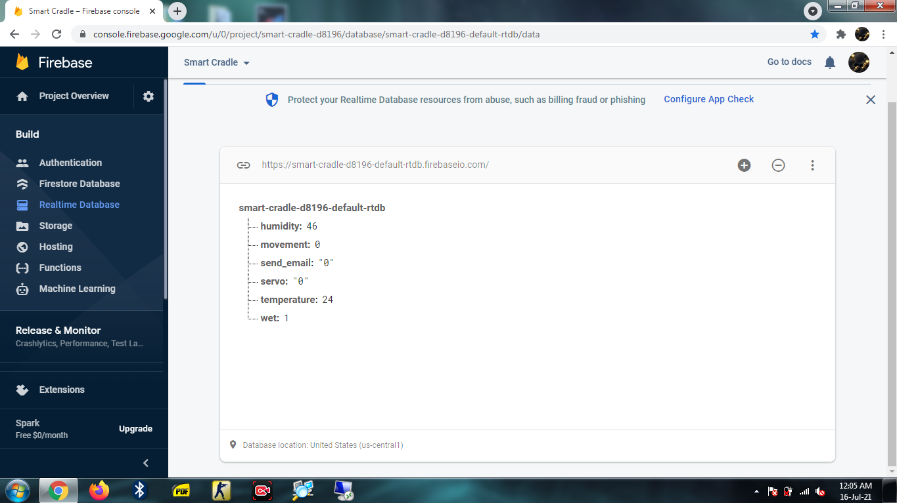
Test result 3

Slide 17
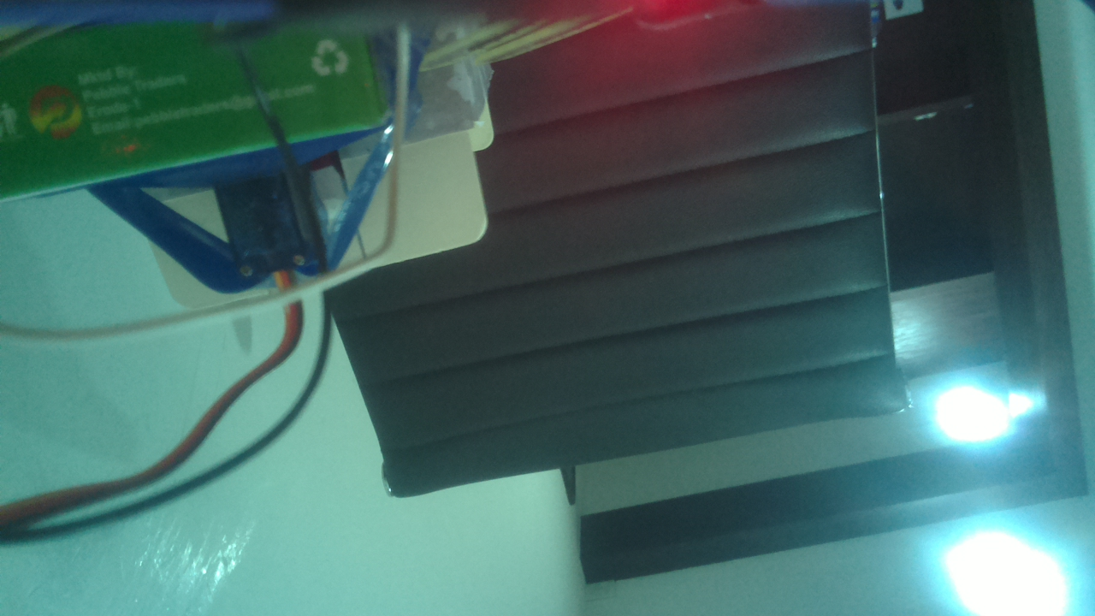
Pi CAMERA SNAPSHOT

Slide 18

E-MAIL SNAPSHOT

Slide 19
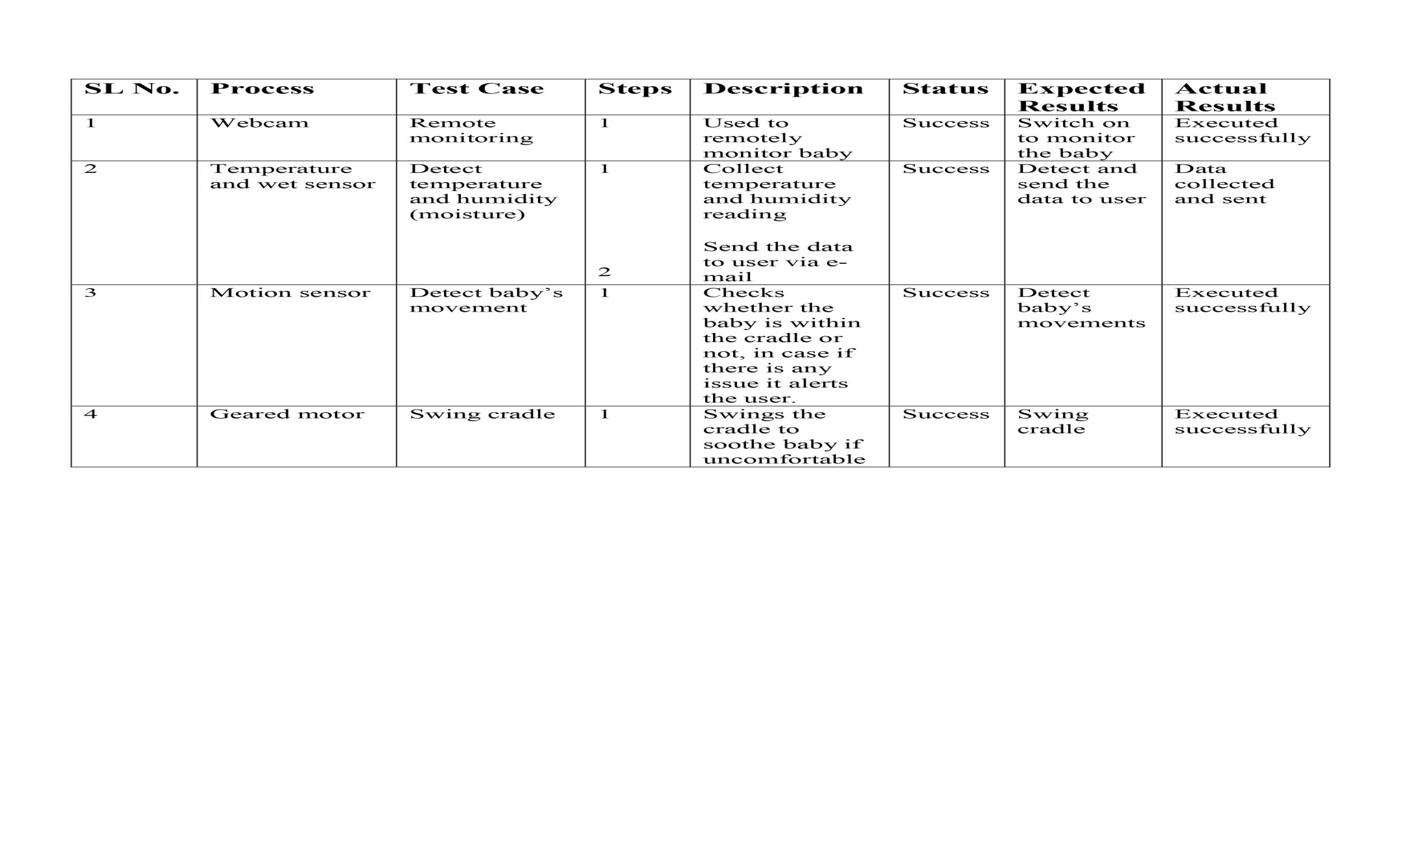
TEST CASES

Slide 20
conclusion
This project describes a smart cradle system which performs various operations such as remote monitoring of baby, detection of baby’s movement using PIR sensor and check baby’s body temperature etc. It employs various features such as sending temperature data to parents and soothing baby by swinging the cradle.

Slide 21
REFERENCES:
[1] Prof. A. R. Patil, “Smart Baby Cradle an IOT based Cradle Management System.”, 2018 International Conference on Smart City and Emerging Technology (ICSCET).
[2] Prof. A.D. Anijkar et.al., “General Idea about Smart Baby Cradle”, Int. J. of Innovative Science and Eng., Jan-Feb 2014.
[3] Aquib Nawaz, “Development of an Intelligent Cradle for Home and Hospital Use”, National Inst. of Technology, 2015.
[4] Rachna Palaskar, Shweta Pandey, Ashwini Telang, Akshada Wagh, Ramesh R. Kagalkar, “An Automatic Monitoring and Swing the baby Cradle for Infant Care” Int.J. of Advanced Research in Computer and Commun. Eng., Dec 2015.

Slide 22
Thank You

